Slide 1


GDSC CAU 22-23
Flutter

Slide 2
Contents
Widget
State

Slide 3

Widget

Slide 4

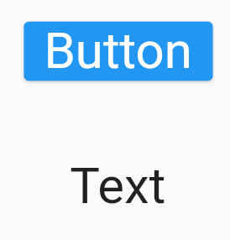
Widget s - What is widget?
ElevatedButton
Text
Column
Row

Slide 5

Widget
Style
Animation

Slide 6
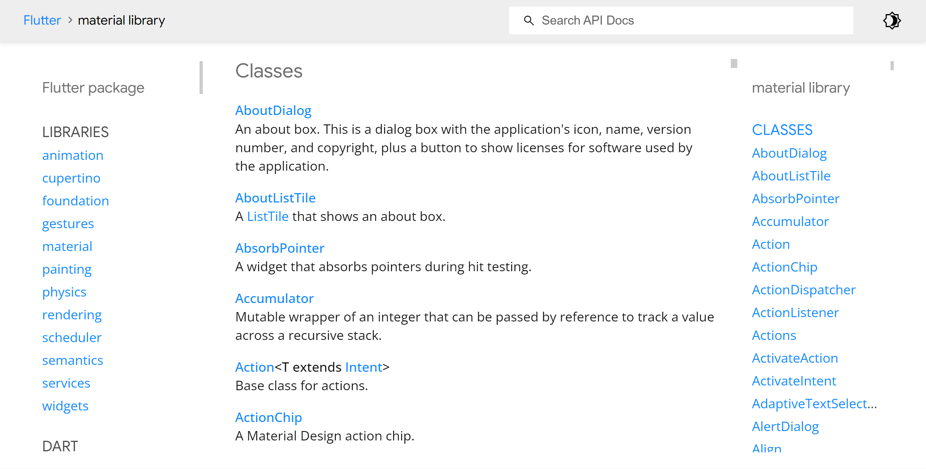
Widget

Slide 7
Widget
- Build
Widget
return
Build

Slide 8
Widget
Parent
Build
Child1
Build
Child2
Build
………

Slide 9
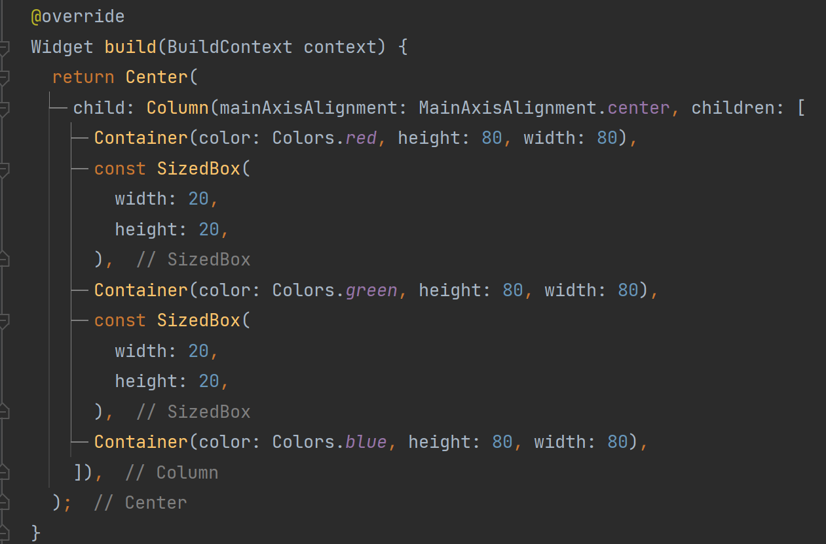
Widget

Slide 10
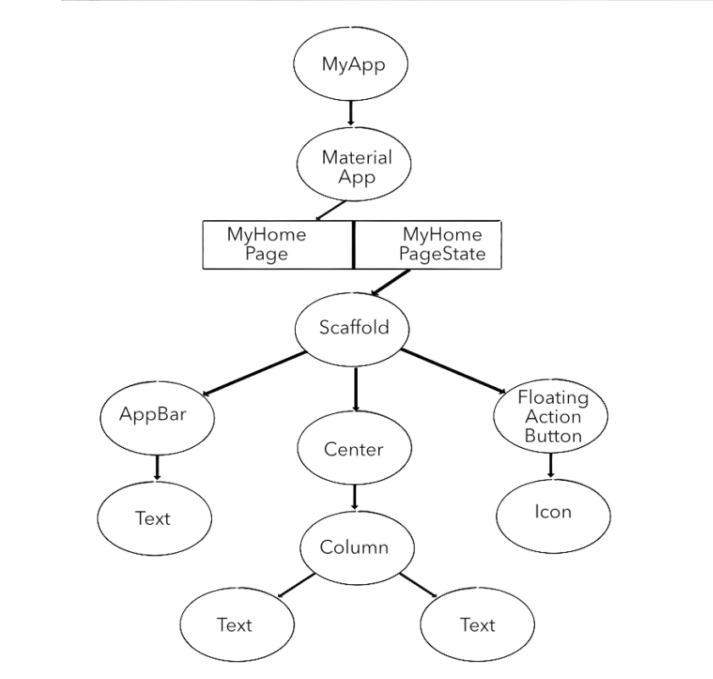
Widget
- Widget Tree

Slide 11
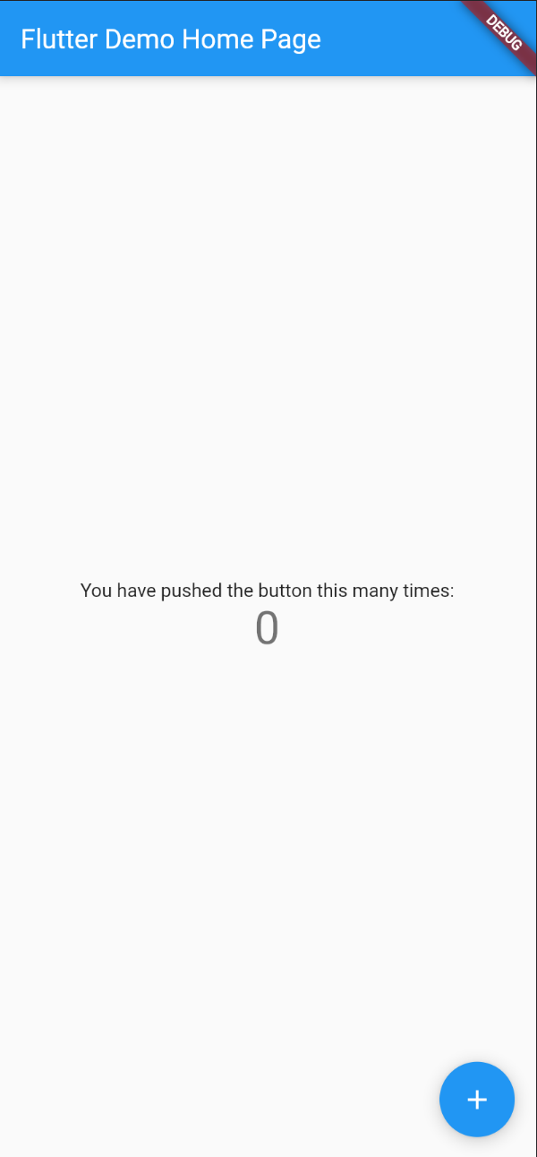
Widget
- Make Counter App
Increment

Slide 12

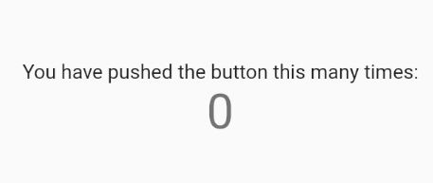

Widget
- App Structure
Container
Text
FloatingActionButton

Slide 13
Widget
Container
Container
Column
Container

Slide 14
Widget
Column
Container
Text
Container
Text
Container
FloatingActionButton

Slide 15
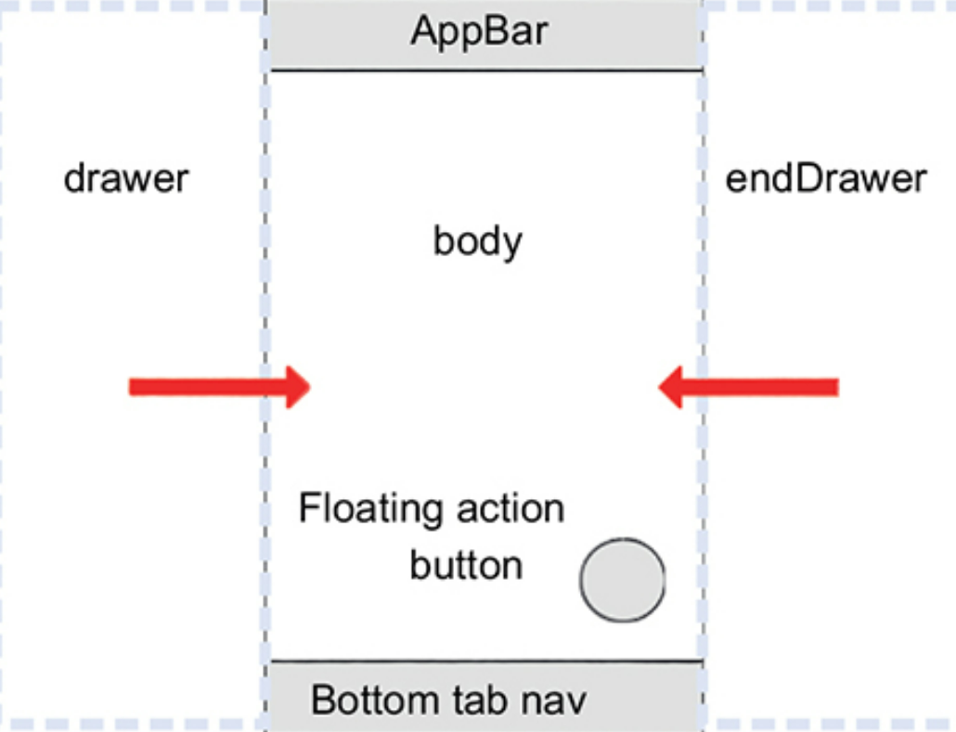
Widget
- Scaffold

Slide 16
State

Slide 17
State
-Update state
Increment
Click

Slide 18
State
-Stateless / Stateful
Stateless Widget
Stateful Widget
State

Slide 19
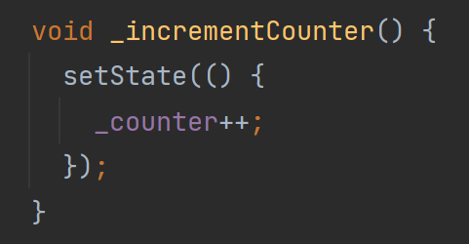
State
-setState
counter
2. rebuild
1. setState
counter++
3. update
counter
<- counter + 1

Slide 20
Summary
Everything is widget
`build` method to render
`setState` to update
Widget tree to represent

Slide 21
Thank you

